Slide 1
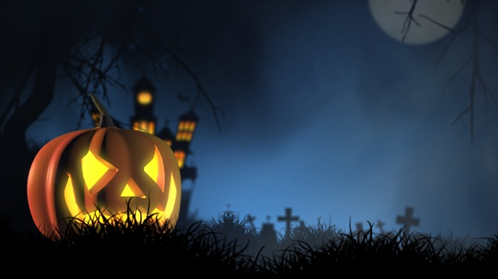
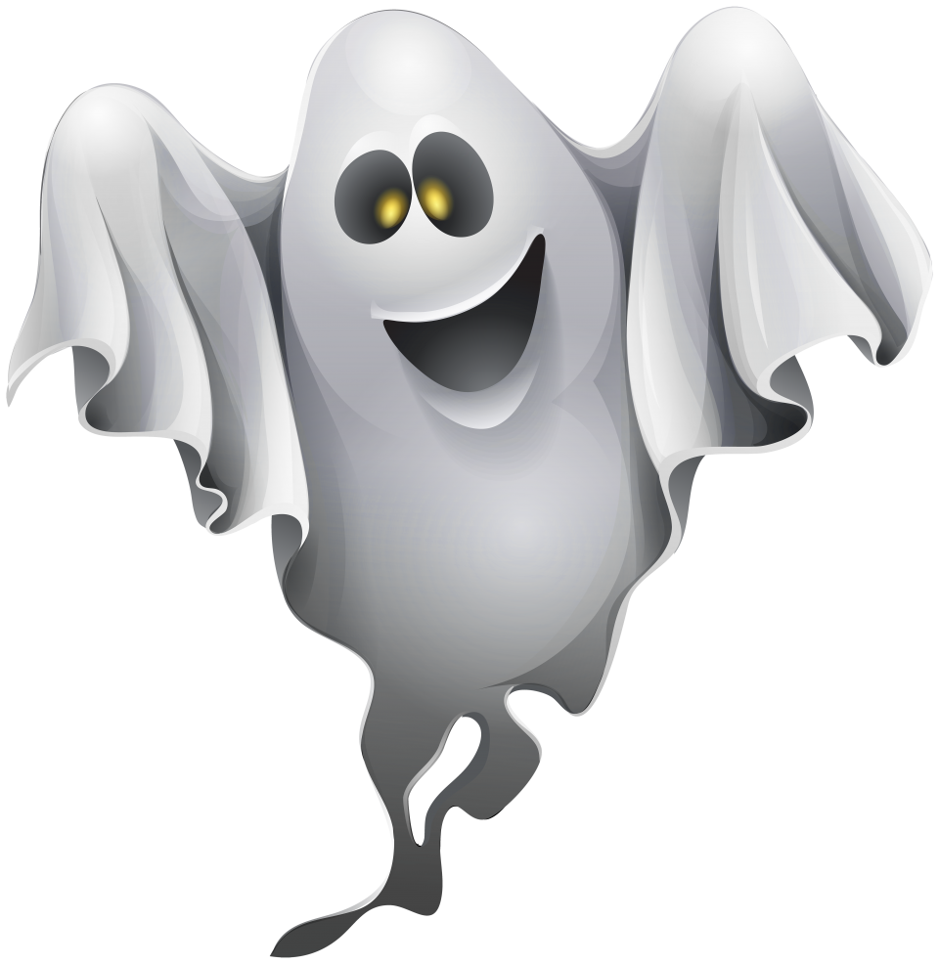

HOLIDAYS;
Halloween

Slide 2

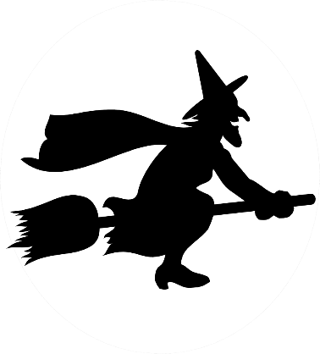

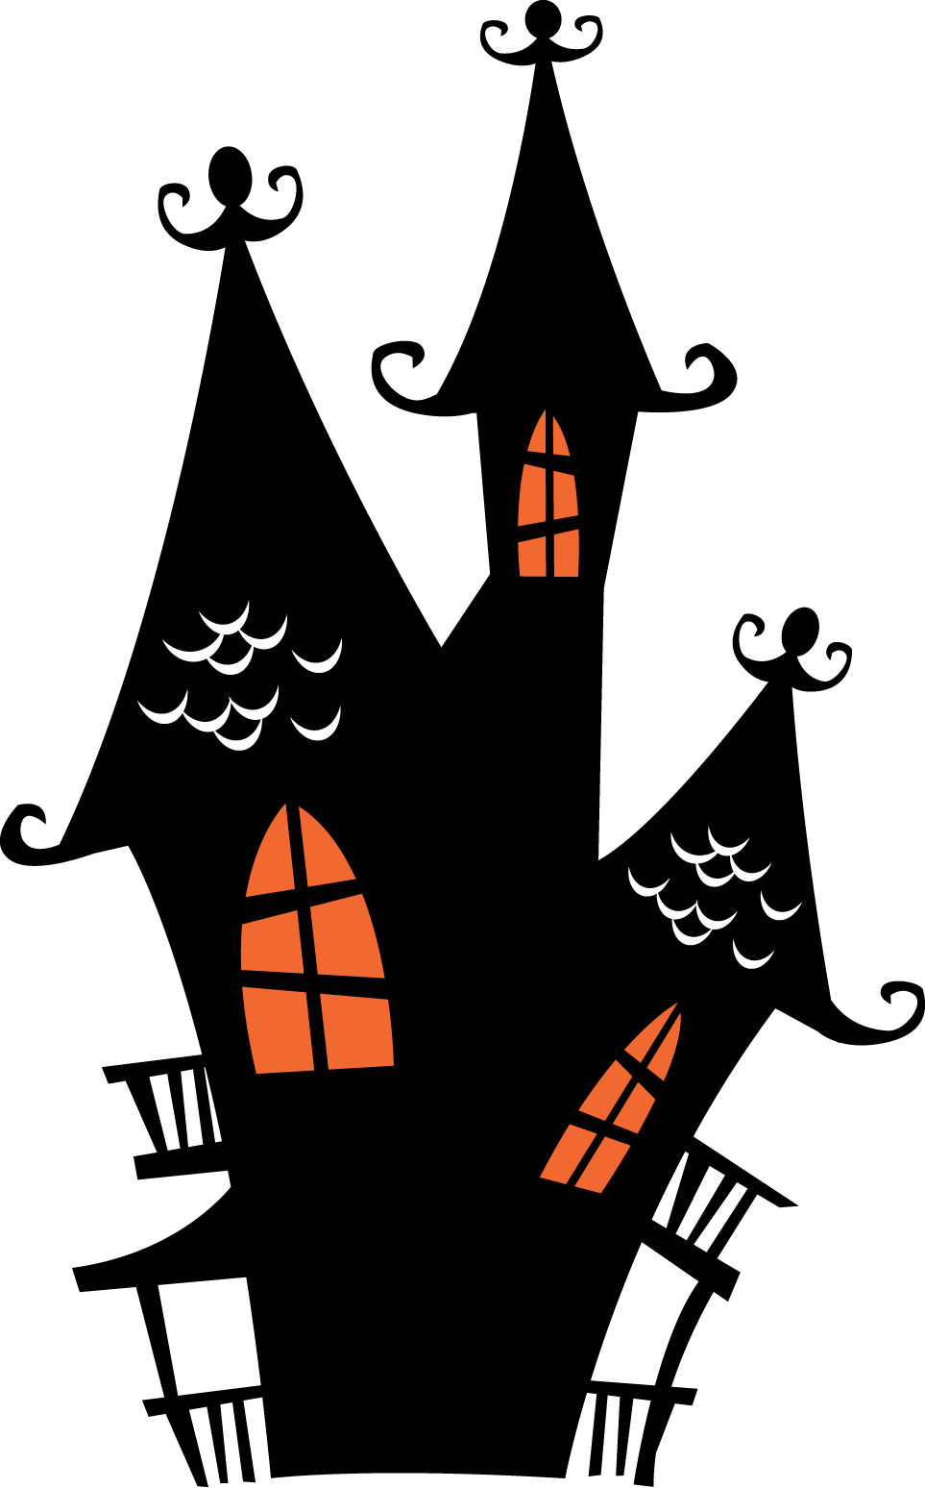

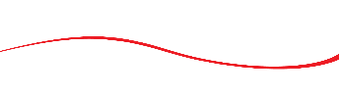
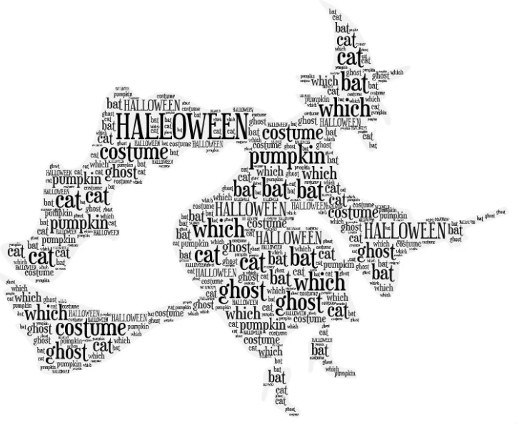

Open your notebook and write down all the words you associate with Halloween. Otvori svoju bilježnicu te se prisjeti riječi vezanih za Noć vještica (Halloween), koje već znaš! Umjesto u bilježnicu ove riječi možeš oblikovati i u sliku koristeći alat na sljedećoj poveznici: https://wordart.com/ i odabirom opcije CREATE NOW!
bat
ghost
cat
HALLOWEEN
When do people in the UK and the USA celebrate Halloween? Kada se obilježava Noć vještica?
Which Halloween traditions do you know? Za koje si običaje vezane za Noć vještica čuo?

Slide 3
Which words connected to Halloween do you already know? Check on the following link. Koje riječi vezane za Noć vještica već znaš? Provjeri na sljedećoj poveznici. https://wordwall.net/resource/23792373
What do you already know about Halloween? Check on the following link. Što već znaš o noći vještica? Provjeri na sljedećoj poveznici. https://wordwall.net/resource/23757642

Slide 4
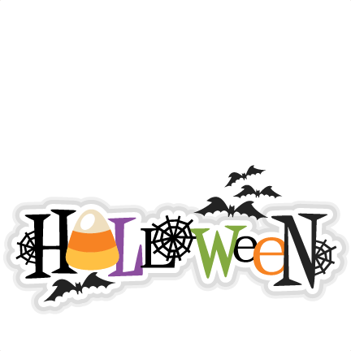
Read the text. Pročitaj tekst o Noći vještica.
Halloween is a celebration on the night of October 31st. It originated from Ireland. The pagan holiday Samhain, which the All Saints holy day replaced, was also known as the Day of the Dead. This day marked the end of summer and the harvest and the beginning of the dark, cold winter, a time of year that was often associated with human death. Celts believed that on the night before the new year, the boundary between the worlds of the living and the dead became blurred. On the night of October 31 they celebrated Samhain, when it was believed that the ghosts of the dead returned to earth.
This is a happy holiday (even though it celebrates death). It is the day that some believed the souls of dead people come back to Earth. In the 20th century Halloween became one of the principal U.S. holidays, particularly among children.
It is most practised in the United States and Canada.
Children wear costumes and go to people's homes saying "Trick or treat!" to ask for candy (sweets in the UK) and people give it to them. The suggestion is: "Give me a treat or I will play a trick on you." People mainly dress up as ghosts, witches, or other scary things for Halloween. It is often referred to as ‘the scariest time of the year’.
Halloween parties often include games such as bobbing for apples, perhaps derived from the Roman celebration of Pomona. Along with skeletons and black cats, the holiday has incorporated scary beings such as ghosts, witches, and vampires into the celebration. Another symbol is the jack-o’-lantern, a hollowed-out pumpkin, originally a turnip, carved into a demonic face and lit with a candle inside.

Slide 5
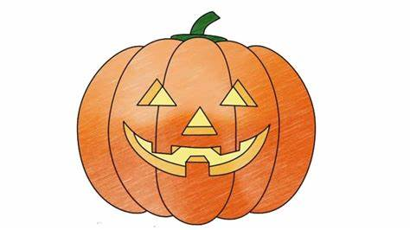
Did you understand the text. Do the following activity! Jesi li razumio text? Riješi sljedeću aktivnost! https://wordwall.net/resource/23792857
If you want to know more check out this link. Želiš li saznati više o povijesti Noći vještica posjeti sljedeći link. https://youtu.be/uyxadwwT2lE
Have you heard the legend about Jack? Legendu o Jacku, po kojem je nazvana izrezbarena bundeva možeš pogledati na sljedećoj poveznici: https://youtu.be/MDVFJwHIK5o
Now you can draw your own spooky jack-o’-lantern. U svoju bilježnicu sada nacrtaj spooky “jack-o’-lantern.”

Slide 6
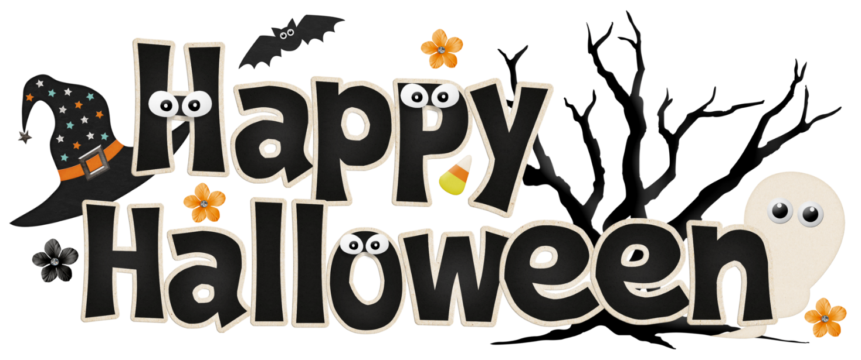
Napiši kratku činkvinu (pjesmu u 5 stihova) o Noći vještica na engleskom! Pravila su jednostavna!
Line 1 - One word, also the title | jedna riječ, naslov
Line 2 - Two adjectives that describe the word in line one | dva pridjeva koji opisuju naslov/temu
Line 3 - Three words that give more information about the subject. | tri riječi koje daju više informacija o temi
Line 4 - Four words that show emotion about the subject or individual words or a phrase | četiri riječi koje izriču osjećaje uz temu, ili fraza
Line 5 - Synonym of the title or a word very similar to it | istoznačnica naslova

Slide 7
Halloween
Scary, spooky
Holiday for children
Jack-o’-lantern pumpkin
Happy Halloween!

